Slide 1

News Dataset and Fake News Detection
Team 4:
Suna Buse Agkoc, Syed Hossian, Yizhe Ling, Fengping Zhao

Slide 2

Agenda
Background & Motivation
Dataset
Description
Cleaning
Design Thinking
Research Questions
Analysis
Model Evaluation
Results
Limitation & Improvement
Practical Implications
Q & A

Slide 3


Background & Motivation
26% of Americans feel confident in their ability to identify fake news, 67% of Americans believe that fake news causes great confusion
Acquire a more comprehensive understanding of fake news and identify effective countermeasures
Reduce or eliminate the misinformation or fake news
* Watson, Amy. “Topic: Fake News in the U.S.” Statista, 21 June 2022, https://www.statista.com/topics/3251/fake-news/.

Slide 4

NLP Open Dataset
“Fake and real news dataset”
Clément Bisaillon
Title, Text, Subject, Date
Two CSVs: fake vs real (40k rows)
Type of Article: News, Politics, Other
Covered from 12/31/2015 - 12/31/2016

Slide 5
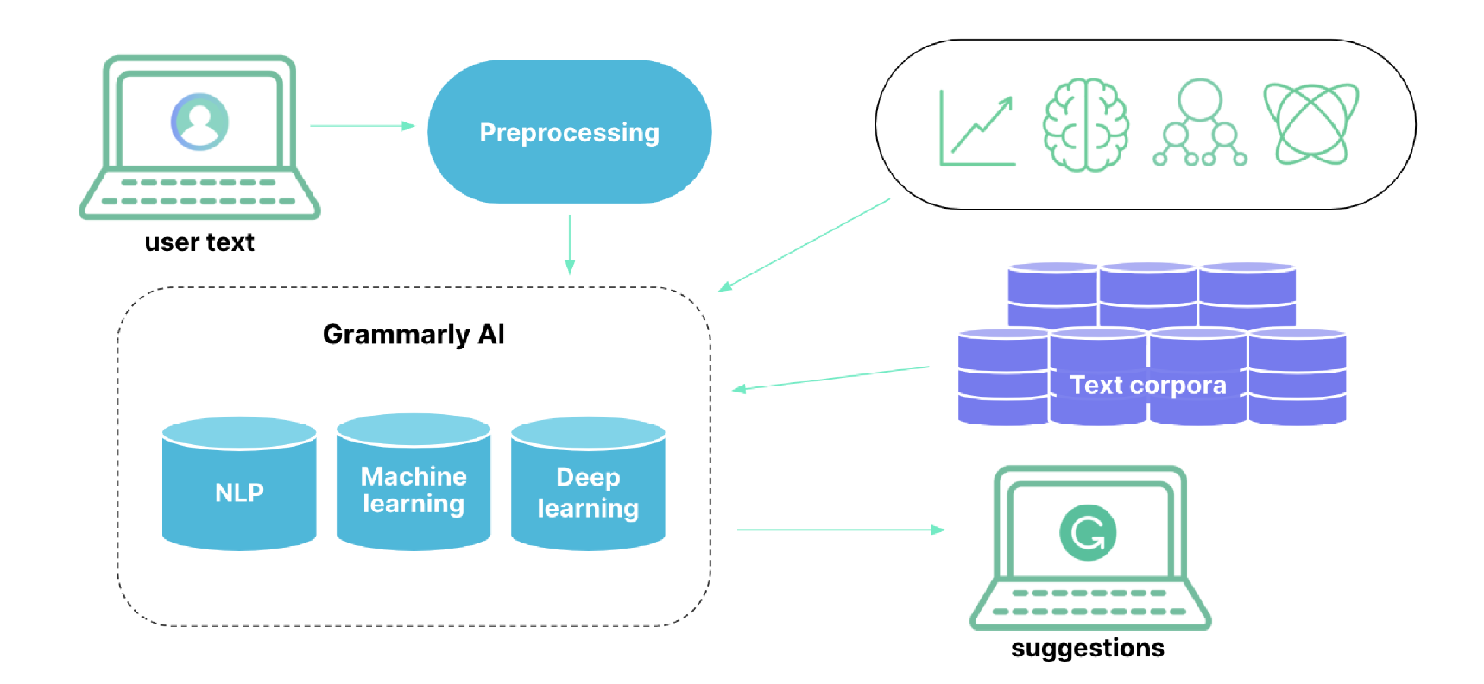
Preprocessing
Normalization
Removing stopwords, punctuation, and numbers
Lemmatization
Stemming

Slide 6
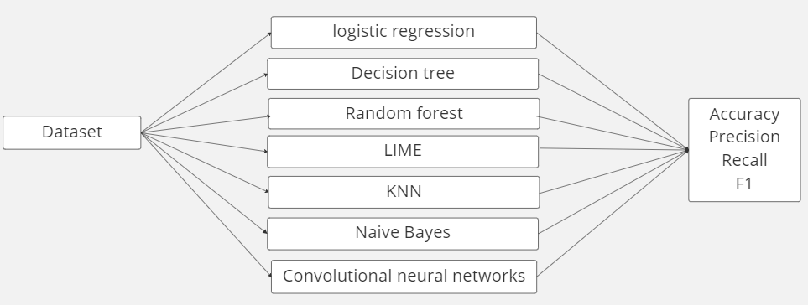
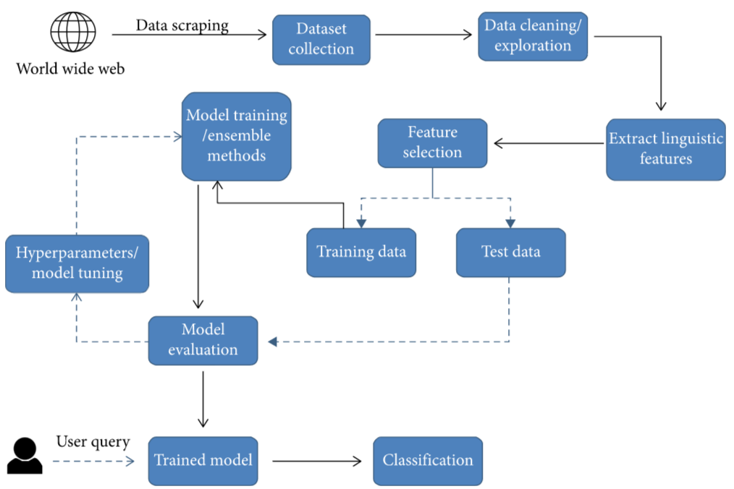
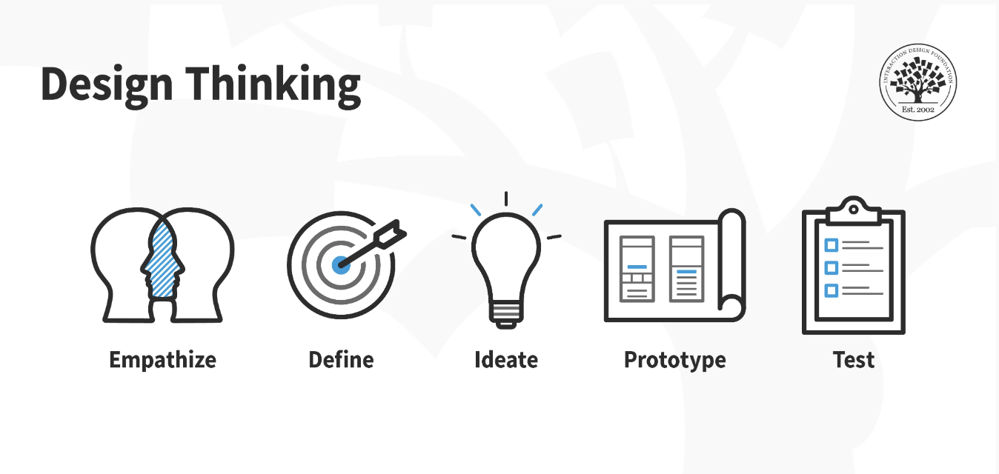
Design Thinking

Slide 7

Research Questions 1
What are the hot topics in fake/real news?

Slide 8
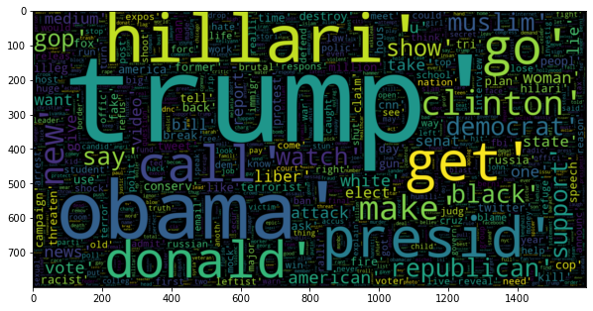
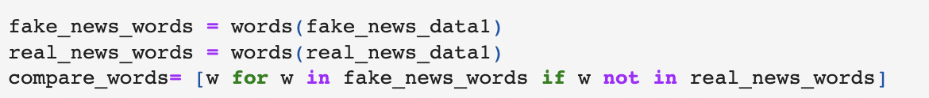
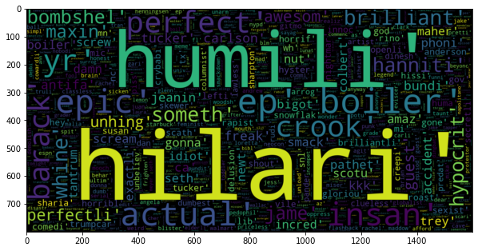
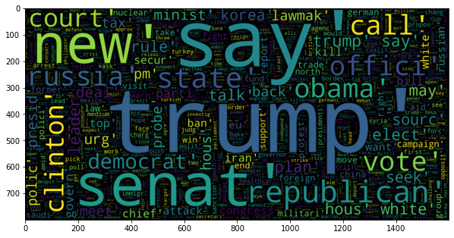
Word Cloud on Fake News
Word Cloud on Real News
Words in Fake news but not in Real news

Slide 9
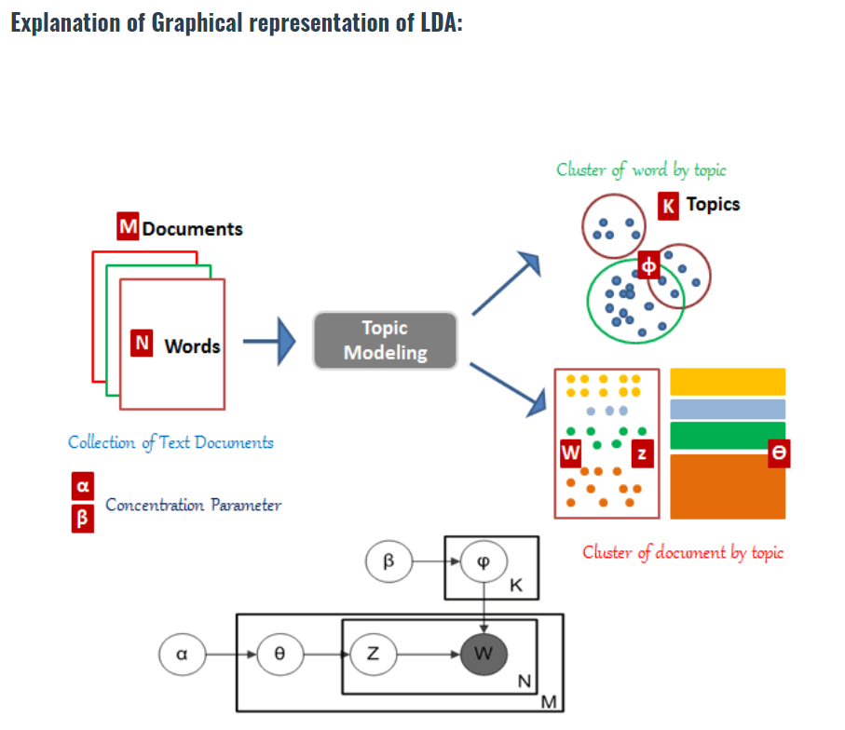
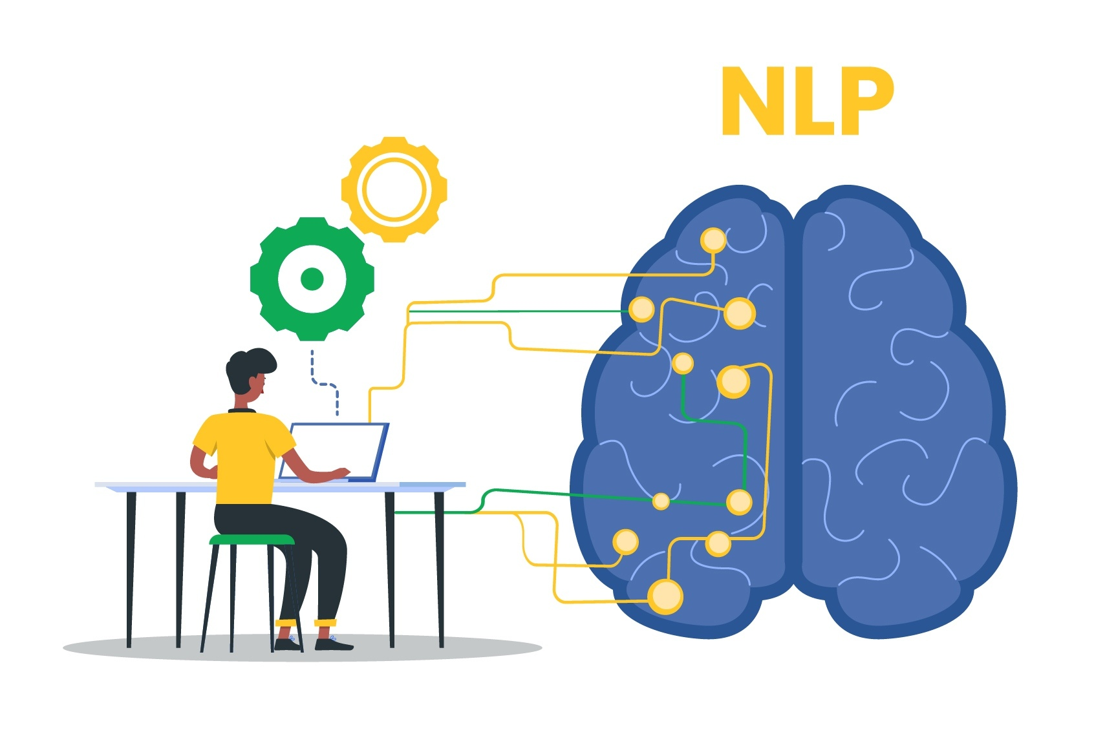
LDA Model
The purpose of the LDA model is to find the topic of the document based on the words in the document.
We need to know how often each term appears in each document by building a document term matrix.
The ultimate goal of LDA is to find an optimal representation of the document-topic matrix and the topic-term matrix.
Two key main inputs, the dictionary(id2word) and the corpus.
Notes:
Cited:https://www.linkedin.com/pulse/nlp-a-complete-guide-topic-modeling-latent-dirichlet-sahil-m

Slide 10
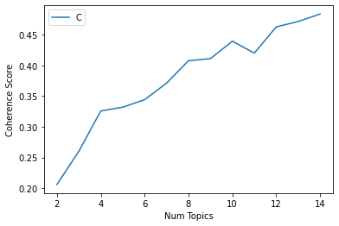
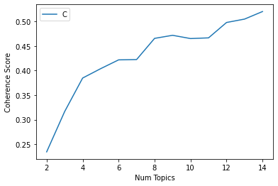
Model Tuning Process
Num of Topics for Fake news LDA model
Num of Topics for Real news LDA model

Slide 11
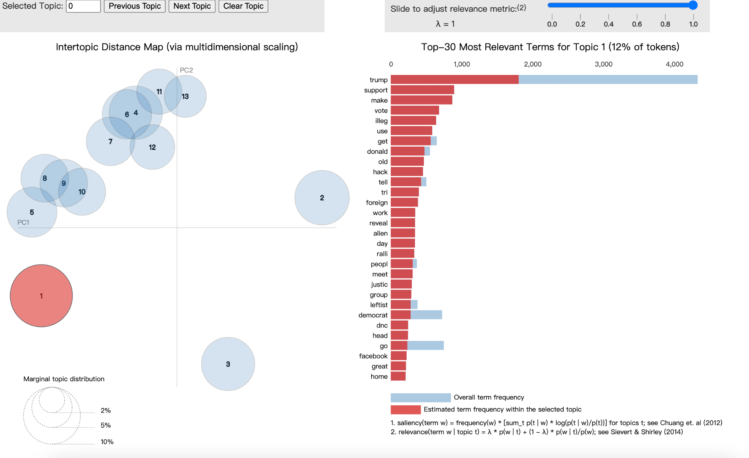
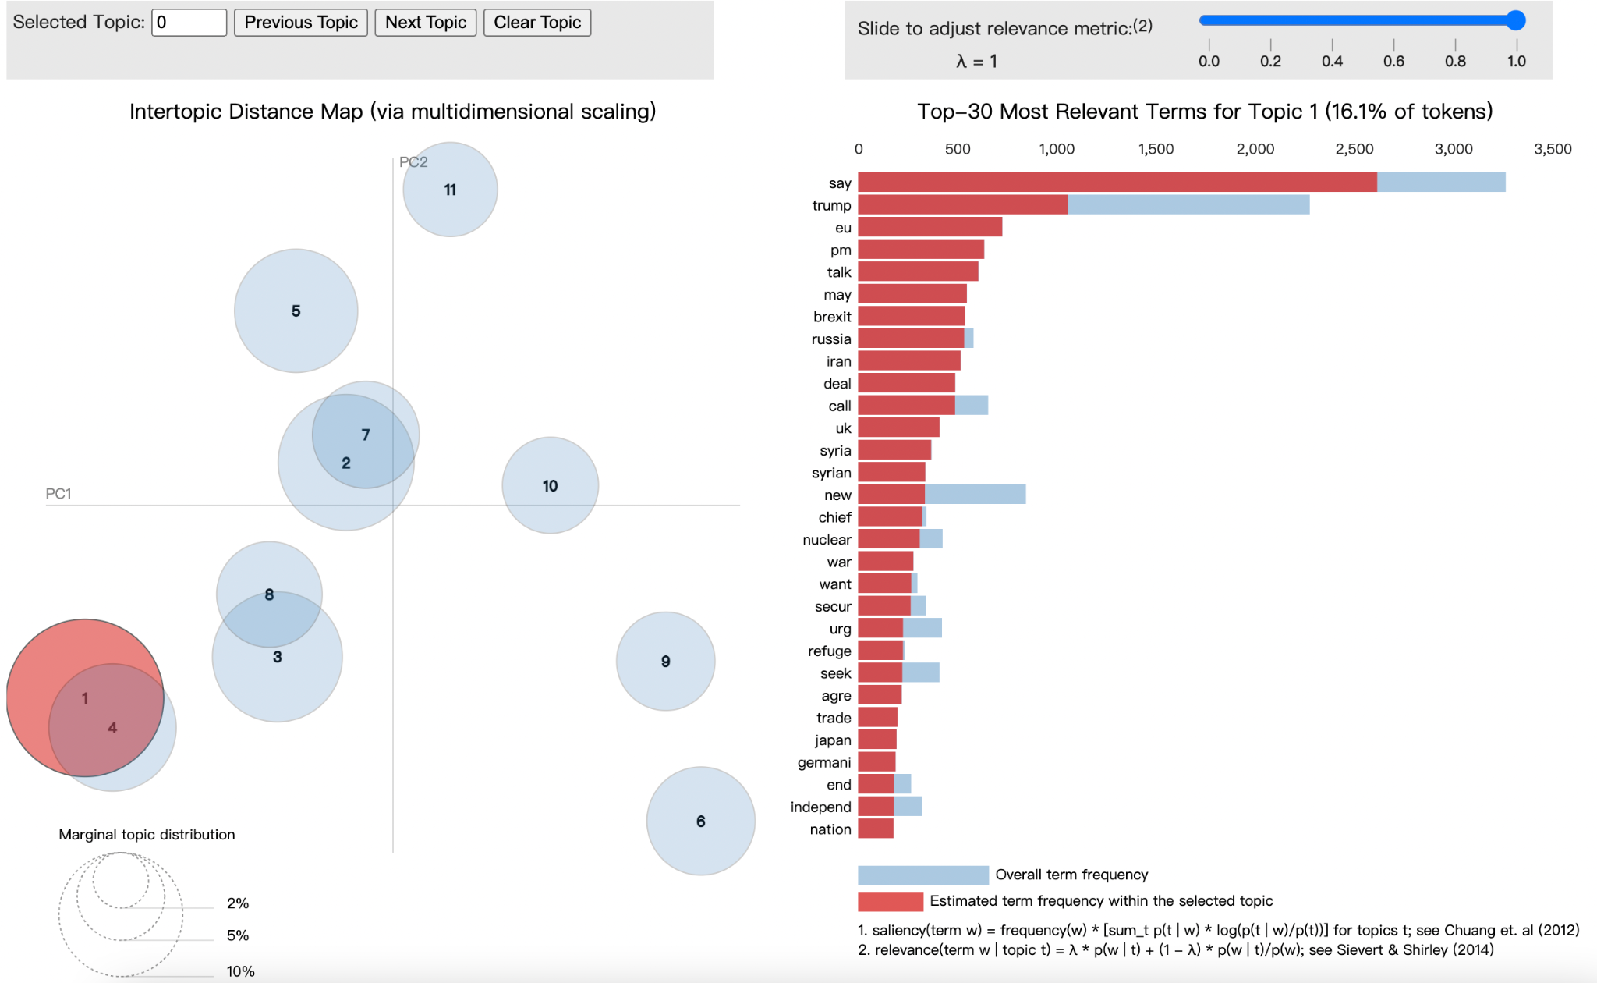
Results- pyLDAvis
pyLDAvis for Fake news LDA model
pyLDAvis for Real news LDA model

Slide 12
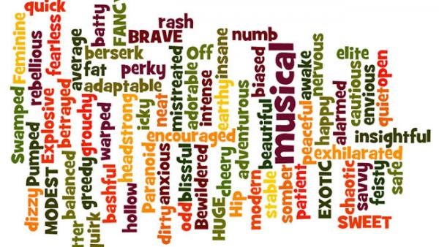
Research Questions 2
Does fake news has more negative connotation words than real news?

Slide 13
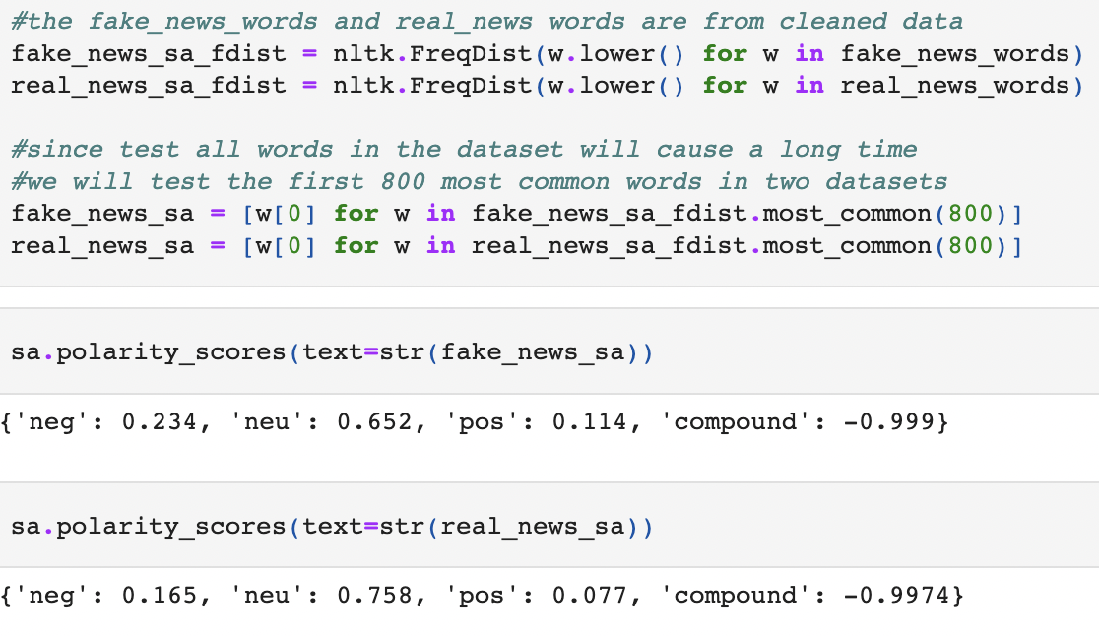
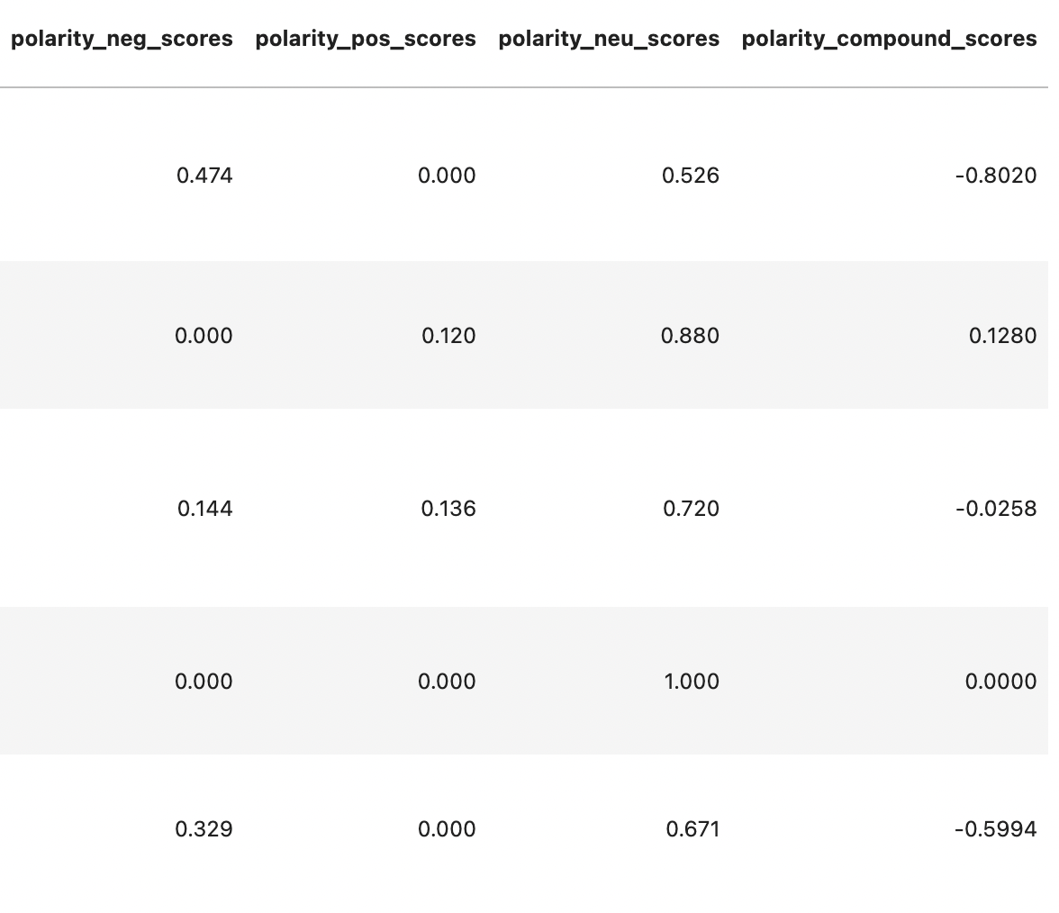
Sentiment Analysis
SentimentIntensityAnalyzer ()
polarity_scores
nltk.FreqDist

Slide 14
Results
Fake news - higher negative and positive polarity score
This result may indicate that fake news is more emotional
Real news is more emotion-neutral

Slide 15

Research Questions 3
How can we classify fake/real news?

Slide 16
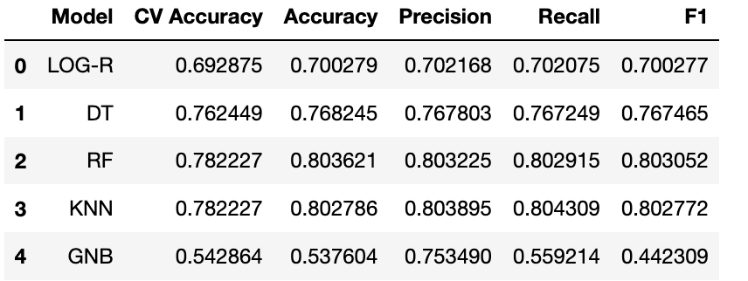
Classification Methods
Logistic Regression
Decision Tree
Random Forest
KNN
Naive Bayes
Classification Features:
Performance Metrics:

Slide 17
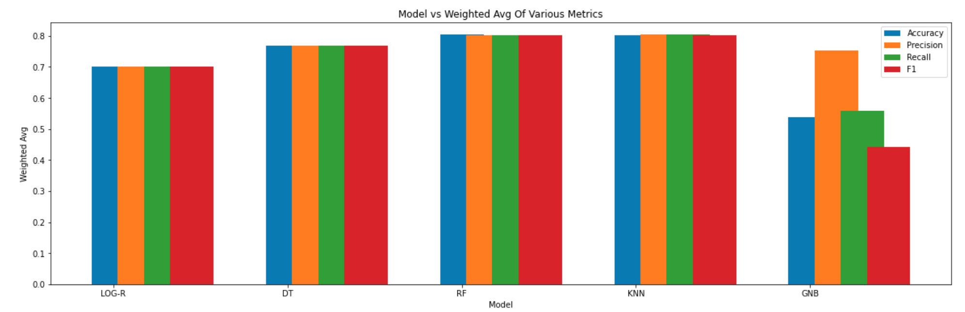
Performance Metrics

Slide 18
Research Questions 4
How can we improve fake/real news classification?

Slide 19
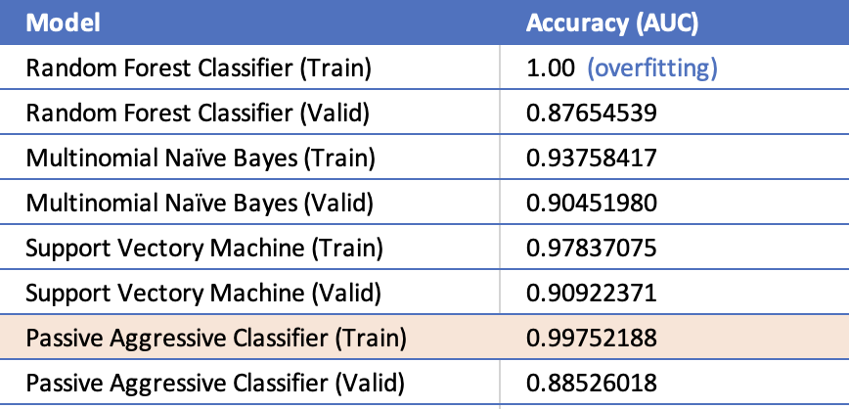
NLP Models
BASELINE AUC ANALYSIS

Slide 20
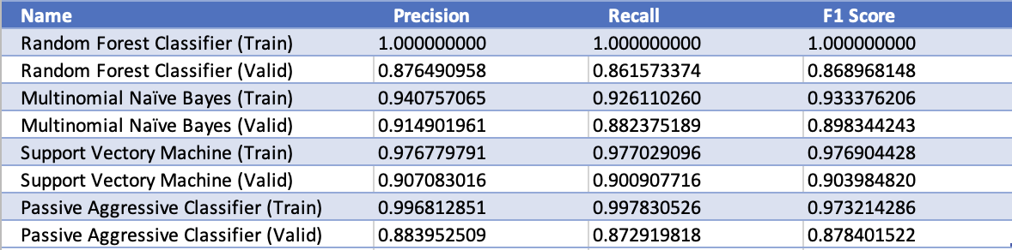
NLP Models’ Performance Metrics

Slide 21
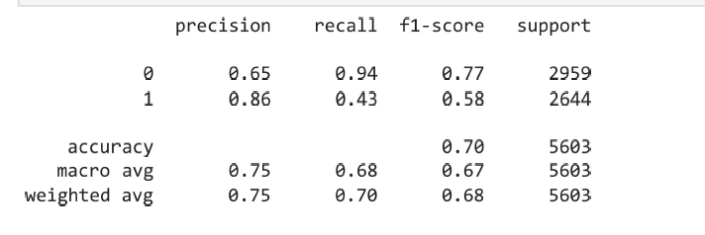
NLP Models: Deep Learning
Convolutional Neural Network

Slide 22
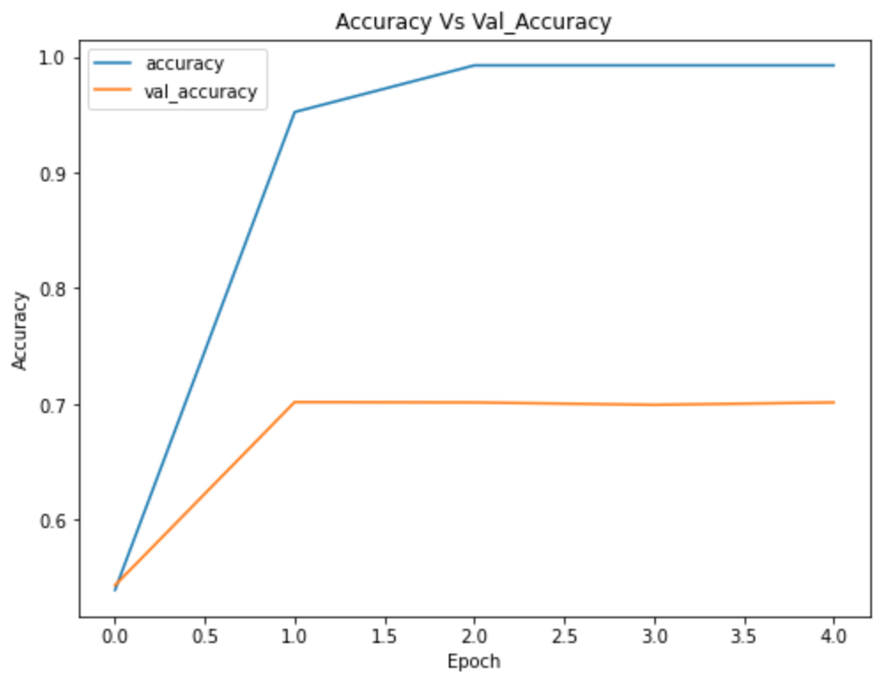
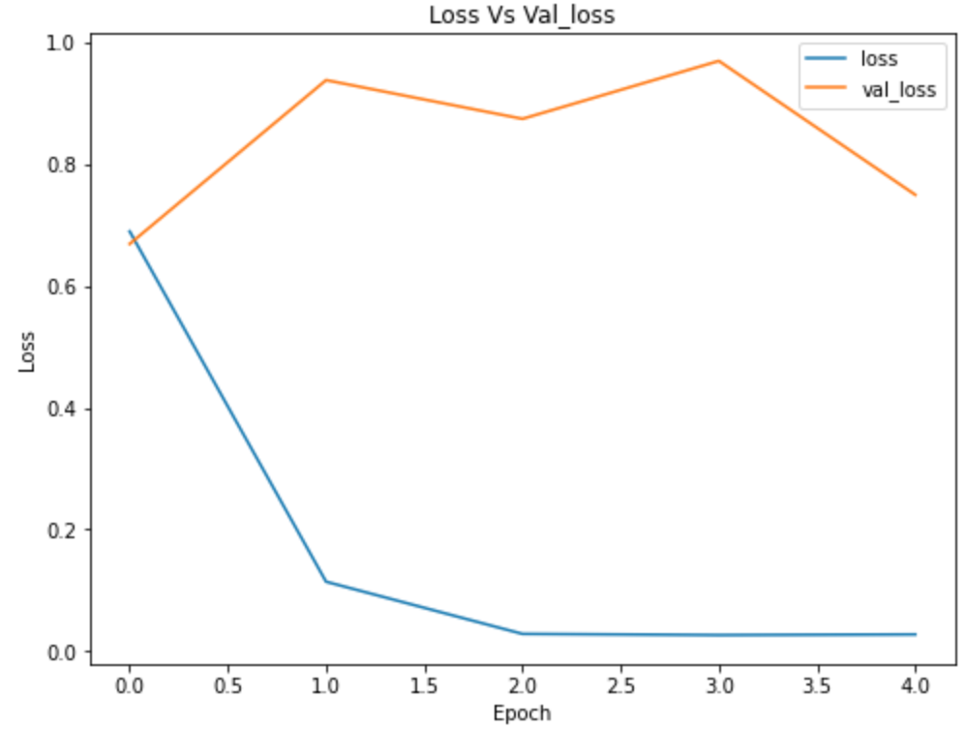
Accuracy and Loss Curves

Slide 23
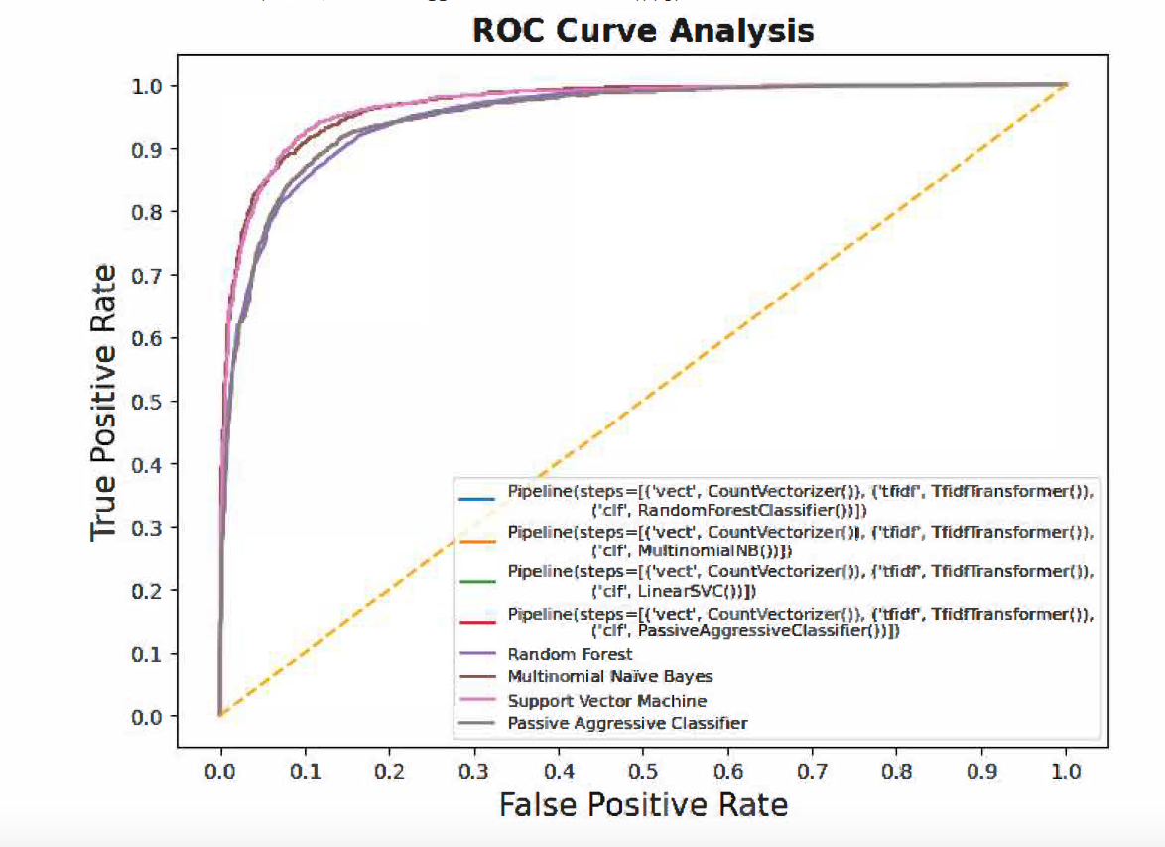
Model Comparison

Slide 24

Limitation & Improvement
Retrieving fresh data
Developing computational models to detect fake information
Improving the features extractions from texts and images
Further strengthen the key features for model development
sentiments of news, frequency of the words used, user information, comments, social network information among users
Consider the characteristics of news consumption environments leveraging insights from social science

Slide 25


Practical Implications
Launching Applications, Mini Programs, or Extensions in cell phones, laptops, tablets, chrome, etc.
Improve people’s ability to identify fake news and their perception of real news
News media can help society reduce social conflict by filtering news that contains more negative connotations
Reduce socially harmful controversies/polarization
Ensure to have a healthier society

Slide 26

Thank you!

